Slide 1
Personalized Medicine and Cancer Treatment
Yepeng Li

Slide 2
Background
Precision medicine is hot topic recent days.
Genetic testing for gene variations.
Cancer treatment will be disrupted by genetic testing.

Slide 3
Data set
Personalized medicine and Cancer treatment(Kaggle competition)
Variables
Gene
Variation
Text
Predict
Mutation class 1-9

Slide 4
Explanatory data analysis
Gene:
Gene frequency in mutation classes
Top genes distribution in different classes
Top 10 occurred genes

Slide 5
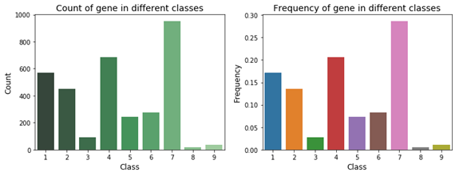
Gene frequency in nine mutation classes

Slide 6
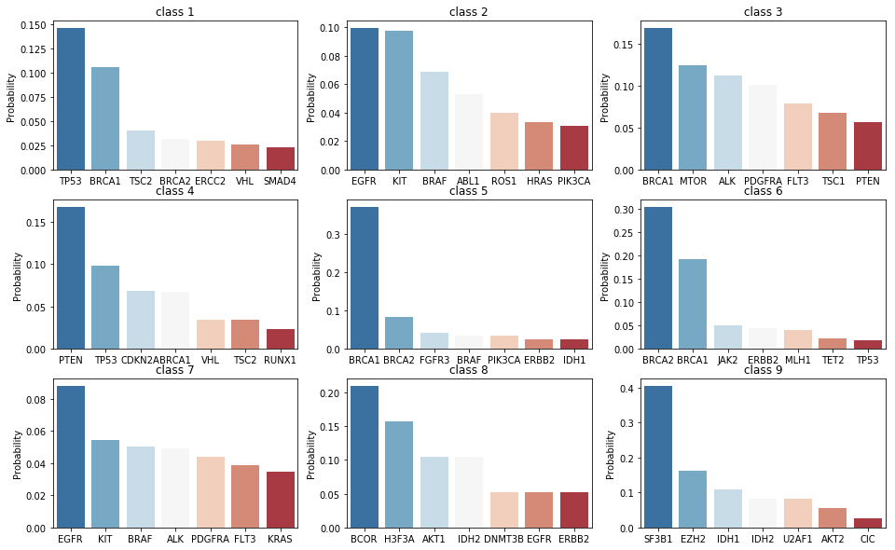
Top seven genes distribution in different classes

Slide 7
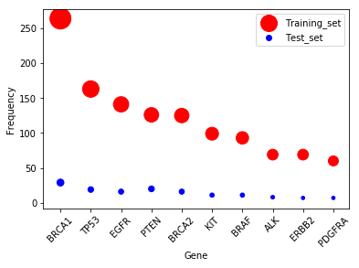
Top 10 occurred genes
Unique genes : 264 (training set)
1397(Test set)
Common top
10 genes: 1

Slide 8
Explanatory data analysis
Variations:
Top 10 Variations
Top variations in different classes

Slide 9
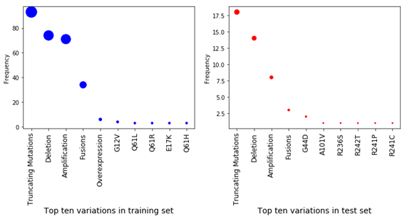
Top 10 variations

Slide 10
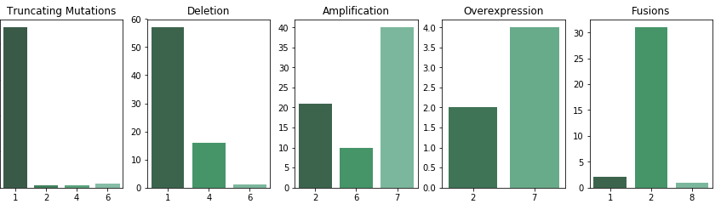
Top 5 variations' class distribution
Top three and top four variations are Amplification and Fusions. They are both mainly located in Class 2 and 7.

Slide 11
Explanatory data analysis
Text:
Text length overview in training set and test set
Text distribution by class in training set
Top 10 TF-IDF features in class 2 and 7

Slide 12
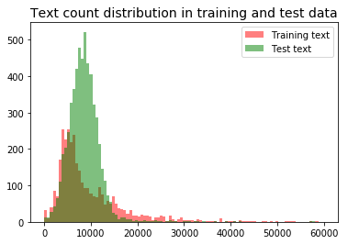
Text length overview

Slide 13
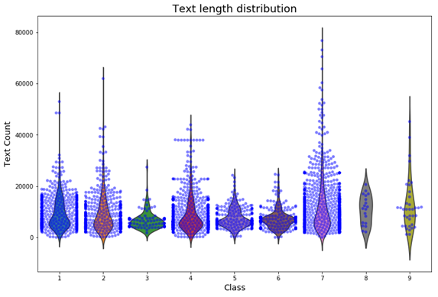
Text length distribution by class

Slide 14
Top 10 TF-IDF features in class 2 and 7
Gene distribution analysis shows top one gene EGFR ranks first in class 2 and 7.
Variation distribution analysis shows Amplification and Fusions (top 5 variations) mainly located in class 2 and 7.
TF-IDF is known as one good technique to use for text transformation.

Slide 15
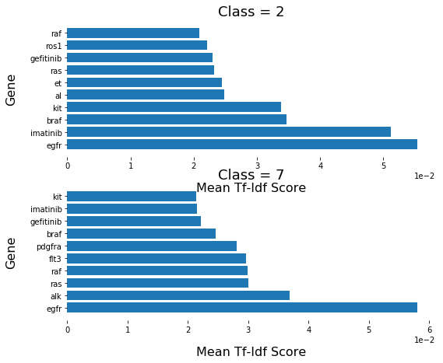
There are seven common text features in the two classes. There are 70% similarity for the top 10 text features between class 2 and class 7!

Slide 16
Base model building without text processing
Using variable 'Gene' and 'Variation' as predictors.
Selecting the variations which count more or equal to 5.
Logistic regression classifier test accuracy is 0.93.

Slide 17
Text processing and Model building
Count vector and TF-IDF

Slide 18
Summary:
Count vector and TF-IDF are used to get word vector.
TF-IDF has better performance than Count vector.
Using Naive bays, Random forest and Gradient boost method to build the classifying model.
The accuracy of test set is from 0.52 to 0.63. GBM performs best.

Slide 19
Count vector and TF-IDF with new stop words
Scientific terminology and stop words
Research field related stop words
Paper notation quirks

Slide 20
Count vector and TF-IDF with new stop words

Slide 21
Comparison of text models with new stop words/ stop words ‘English’
Log loss
Accuracy

Slide 22
Truncated SVD
 | log loss | test accuracy
Truncted SVD + Logistic regression | 1.54 | 0.48
Truncted SVD + Random Forest | 1.33 | 0.53
Truncted SVD/TFIDF + Logistic regression | 1.52 | 0.46
Truncted SVD/TFIDF + Random Forest | 1.34 | 0.5
Truncted SVD/TFIDF + Support vector machine | 1.43 | 0.48

Slide 24
Word2vec
 | log loss | test accuracy
Logistic regression | 1.37 | 0.51
Random Forest | 1.37 | 0.52
Word2vec is a group of related models that are used to produce word embedding.
These models are shallow, two-layer neural networks that are trained to reconstruct linguistic contexts of words.

Slide 25
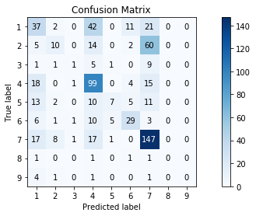
LSTM
Keras Model:
Log loss: 1.37
Accuracy: 0.50

Slide 26
Comparison of five methods

Slide 27
Future job
Trying to find better way to get word vector.
Normalizing text data. For example, deleting the duplicate parts, citing only the abstract part of the paper.

